Slide 1


Community SRM
Empowering Innovation, One Awesome Hack at a Time!

Slide 2

Community SRM
Sustaino
Team Name: git unstash
Team Lead: Jai Khurana
Track: Open Innovation

Slide 3


Community SRM
PROBLEM STATEMENT
Environmental & Health Crisis:
• Our world faces mounting environmental degradation despite technological progress.
• Public health is impacted by unsustainable lifestyles and environmental stressors.
Lack of Accessible Sustainable Choices:
• Many people struggle to find practical, everyday solutions that support both the planet and their well-being.

Slide 4
Community SRM
PROPOSED SOLUTIONS
Sustaino Overview:
• A mobile app that empowers users to make sustainable choices every day.
• Focuses on “dual sustainability” – promoting both environmental health and personal wellness.
Core Features:
• Health Impact Analysis – Evaluates product nutrients and ingredients to assess their impact on personal wellness.
• Environmental Impact Assessment – Analyzes packaging materials and sourcing to determine sustainability.
• Better Alternatives Recommendation – Suggests healthier and more eco-friendly product options.

Slide 5
Community SRM
PROPOSED SOLUTIONS
Empowerment Through Information:
• Provides actionable insights and personalized recommendations.
Integrated Sustainability:
• Integrates eco-conscious shopping, mindful consumption, and personal well-being into a single platform.
Data-Driven & User-Centric:
• Leverages advanced data processing and AI to deliver real-time, tailored suggestions.
Real-World Impact:
• Small, informed choices made by many users contribute to a larger sustainable change.

Slide 6
Community SRM
TECHNICAL APPROACH
Frontend:
• Swift (iOS) – Developing a smooth, native app using UIKit for an intuitive user experience.
Backend & API Services:
• FastAPI – Handles requests between the frontend and machine learning model.
• Firebase Firestore – Stores extracted text from OCR for further processing.
Data Management & Processing:
• Tesseract OCR – Extracts product text for analysis.
• LangChain & LlamaIndex – Processes and structures extracted data.
• Neo4j – Builds a knowledge graph for better insights.
• Tavily Search Tool – Enhances sustainability data retrieval.

Slide 7
Community SRM
AI & Inference:
• Hugging Face Models – Provides NLP capabilities for sustainability scoring.
• Google PaLiGemma Multimodal Model – Analyzes product images and text.
• Mistral Model – Enhances natural language understanding.
• Groq-LPUs – Powers efficient AI-driven insights.

Slide 8
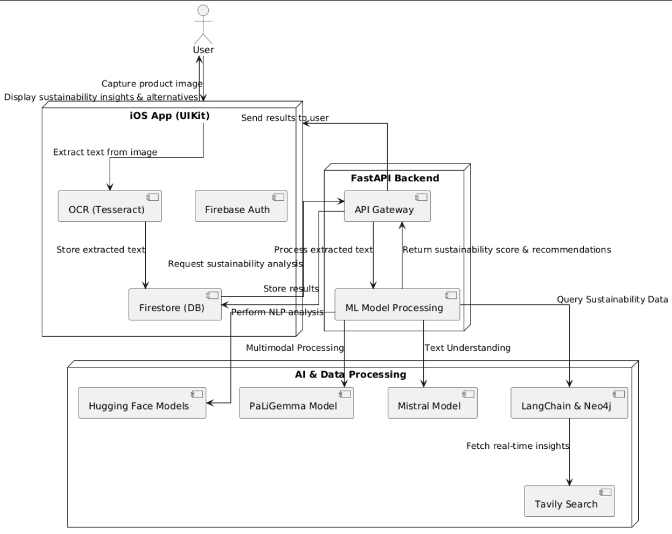
TECHNICAL APPROACH
Community SRM

Slide 9
Community SRM
FEASIBILITY & SCALABILITY
Practicality:
• Designed to integrate into daily routines with simple, actionable insights.
• Addresses both immediate sustainability needs and long-term lifestyle improvements.
Scalability:
• Modular architecture supports the addition of new features and services.
• Utilizes scalable cloud services and microservices to handle increased user demand.
Future-Proof:
• Emphasis on data privacy, security, and efficiency ensures reliability as the platform grows.

Slide 10
Community SRM
TEAM MEMBERS
Team Lead: Jai Khurana
Email: jk8830@srmist.edu.in
Phone: 9354883198
Member 2: Abhinav Rajeev Kumar
Email: ak0929@srmist.edu.in
Phone: 9667882568
Member 3 (Optional): Jayesh Gaba
Email: jg9140@srmist.edu.in
Phone: 7055050777
Member 4 (Optional): Shivaya Pandey
Email: sp9018@srmist.edu.in
Phone: 9410783634

Slide 11

Community SRM
INSTRUCTION: You can remove this during submission!
Keep your presentation within 10 slides.
Stick to the OSSome Hacks 2.0 slide template for a uniform look.
Use bullet points, visuals, and diagrams instead of heavy text blocks.
Ensure clear fonts, proper contrast, and minimal clutter on each slide.
Do not copy content directly from AI tools, ensure all ideas are your own.
For any queries, reach out to events@githubsrmist.tech or contact the organizing team (Utkarsh Jaiswal - 9315715875, Diptayan Jash - 9474182596)
For additional queries, join our official
Ossome Hacks 2.0 Discord
Github Community SRM | Email: community@githubsrmist.tech | Website | Instagram | LinkedIn

